Slide 1









My Algebra Interactive Notebook
$$×$$
$$\frac{1}{2}$$
$$÷$$
$$+$$
$$−$$
$$\frac{3}{5}$$
$$7$$
Name
Class
Teacher
Term 1 Semester 1
$$5^{2}$$
$$\sqrt{9}$$
1

Slide 2
Contents
Glossary or Formula Page
Page
Date
Description
2
3

Slide 3
Tasks
24
7
30
Essential Question
Questions
Notes
Summary
6
7

Slide 4
24
7
30
Date
Index Notation
EQ – How do I expand a number written in index form?
7

Slide 5



24
7
30
Date
Index Notation
EQ – How do I calculate the value of a number to the power of a positive or negative integer?
What is index notation?
Index or exponent
Base
$$3^{5} =3×3×3×3×3$$
Power Form
or index form
Extended or expanded form
The index shows the number of times the base is multiplied by itself
How to you evaluate a base to the power of one or zero?
$$a^{1}=a e.g. { 12}^{1}=12$$
$$a^{0}=1 e.g. { 15}^{0}=1$$
7

Slide 6

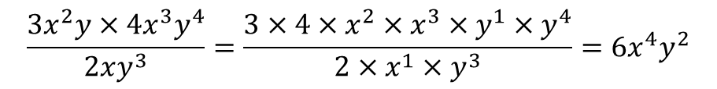

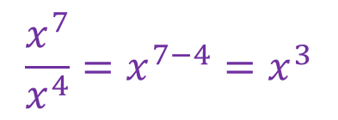

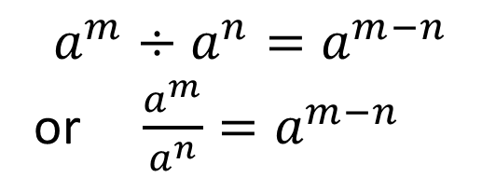
24
7
30
Date
Index Laws
EQ – Describe how the index laws can be used to simplify expressions with indices.
What are the index laws?
Index Law 1
Example
$$a^{m}×a^{n}=a^{m+n}$$
$$x^{7}×x^{4}=x^{7+4}=x^{11}$$
Index Law 2
$$a^{m}÷a^{n}=a^{m−n}$$
or $\frac{a^{m}}{a^{n}}=a^{m−n}$
$$x^{7}÷x^{4}=x^{7−4}=x^{3}$$
$$\frac{x^{7}}{x^{4}}=x^{7−4}=x^{3}$$
Example
Simplify
$$\frac{3x^{2}y×4x^{3}y^{4}}{2xy^{3}}=\frac{3×4×x^{2}×x^{3}×y^{1}×y^{4}}{2×x^{1}×y^{3}}=6x^{4}y^{2}$$
5

Slide 7

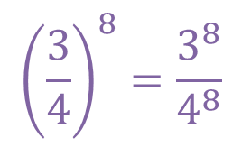
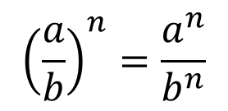


24
7
30
Date
Index Laws
EQ – Describe how the index laws can be used to simplify expressions with indices.
What are the index laws?
Index Law 3
Example
$$({a^{m})}^{n}=a^{mn}$$
$${(x^{7})}^{4}=x^{7×4}=x^{28}$$
Index Law 4
$$({a×b)}^{n}=a^{n}×b^{n}$$
$${(6×3)}^{4}=6^{4}×3^{4}$$
Index Law 4
$${\left(\frac{a}{b}\right)}^{n}=\frac{a^{n}}{b^{n}}$$
$${\left(\frac{3}{4}\right)}^{8}=\frac{3^{8}}{4^{8}}$$
5

Slide 8
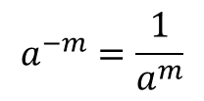
24
7
30
Date
Negative Indices
EQ – Describe the effect of a negative indices on a number.
What is the rule for negative powers?
$$a^{−m}=\frac{1}{a^{m}}$$
$$a^{m}=\frac{1}{a^{−m}}$$
Examples
$$5^{−2}=\frac{1}{5^{2}}=\frac{1}{25}$$
$$a^{−2}b^{4}=\frac{1}{a^{2}}×b^{4}=\frac{b^{4}}{a^{2}}$$
5

Slide 9
Exercises
Exercise 1.1 and 1.2 from Dwyer
Also Indices Revision 2
And
Mixed Indices Laws – Mathspace handout.
All to be done with a smile on your faces.

Slide 10
Notes Review
24, 7 ,30
Date
Title
Essential question
Notes complete
Notes complete with colour and diagrams
Questions completed
Contents page filed in
Formula page filled in

Slide 11
Homework
Review your notes and write a summary answering the essential question.

